Slide 1


Slide 2
The team
Rowdy –10+ years in software development, Ethereum Foundation grantee, ETH Denver 2021 virtual top 3, DAOHaus contributor, Raidguild member, ex-Deloitte
Tconomist – advanced degree in economics and finance, game theory and tokenomics scholar, published a research paper on DeFi and financial inclusion, Community and Partnerships @XYZ.ai
Huntrr – 2 times ETH Global hackathon winner, taught Solidity smart contracts security courses, freelance DAO software developer, active Raidguild contributor, Hats protocol contributor

Slide 3




Sad reality of DAOs today
According to our most conservative estimates based on the data from DeepDAO, there is at least 200 million worth of USD locked in and decaying in DAOs with under 5% voter participation, excluding DEXs, liquidity providers and other DINOs (DAOs in name only)

Slide 4
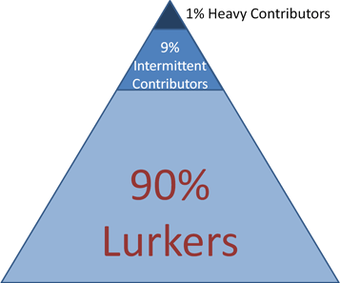
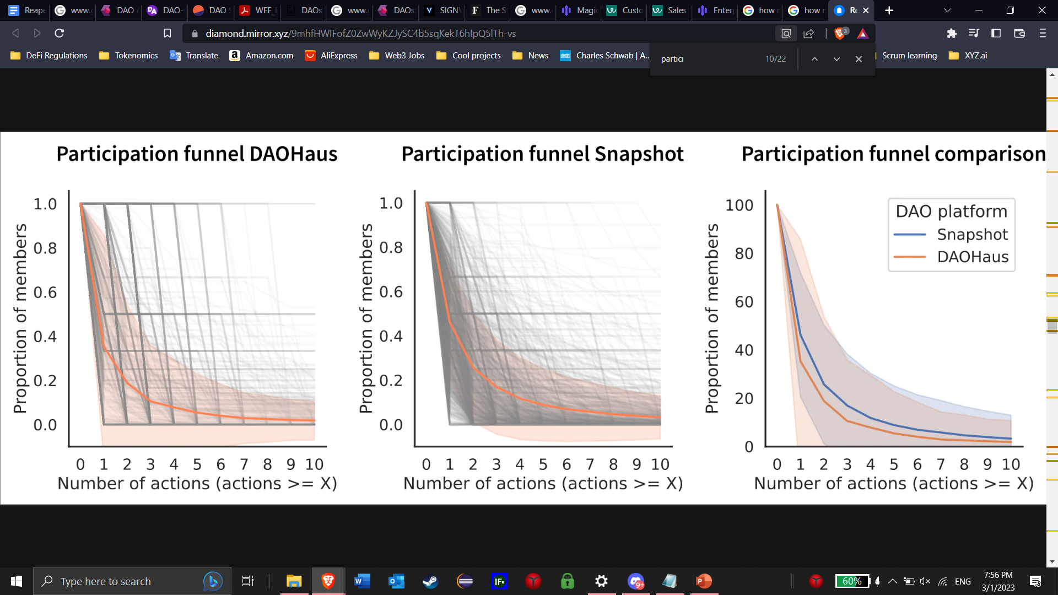
Problem
DAOs, alike to other forms of un(der)structured human organization, follow the 90/9/1 rule, which often puts them at risk of treasury capture by the 1% with the relative lowering quorum due to inactivity
DAOs suffer from low participation over time due to the lack of engagement incentives tooling
DAOs have no on-chain reputation system that would hold them accountable and inspire trust in them for current and future members
Notes:
DAOs by nature follow the 90/9/1 rule, so DAOs often suffer from low engagement over time and potential malevolent behavior by a colluding core of heavy contributors. Therefore, DAOs are often at risk of treasury capture by the 1%, who can decide to collude, intentionally keep shutting down/ignore the proposals and not sign the multisig authorizing the transactions, discouraging the 99%, driving down the activity/engagement and ultimately just seizing the treasury.

Slide 5
Solution
A Dead Man’s switch (the Reaper) that listens to see if the DAO is still active and reputable. If the DAO’s reputation falls below 0 by failing to meet the metrics threshold that was configured on deployment of the Reaper to the DAO, the Reaper liquidates the treasury sending the funds to the public goods fund
This solves the three main issues:
It makes the treasury capture more difficult (due to an easily attainable quorum with inactive and leaving members) by wiping out the about to be captured treasury proactively
It gives all members an incentive to be more active, especially for the more involved members to get less involved members to participate, collectively breaking the 90/9/1 paradigm
It creates an on-chain reputation scoring, which helps create accountability and trust in DAOs
Notes:
It makes the treasury capture more difficult (due to an easily attainable quorum with inactive and leaving members) by wiping out the treasury proactively
It gives all members an incentive to be more active, especially for the more involved members to get less involved members to participate, collectively breaking the 90/9/1 paradigm
It creates an on-chain reputation scoring, which helps create accountability and trust in DAOs

Slide 6
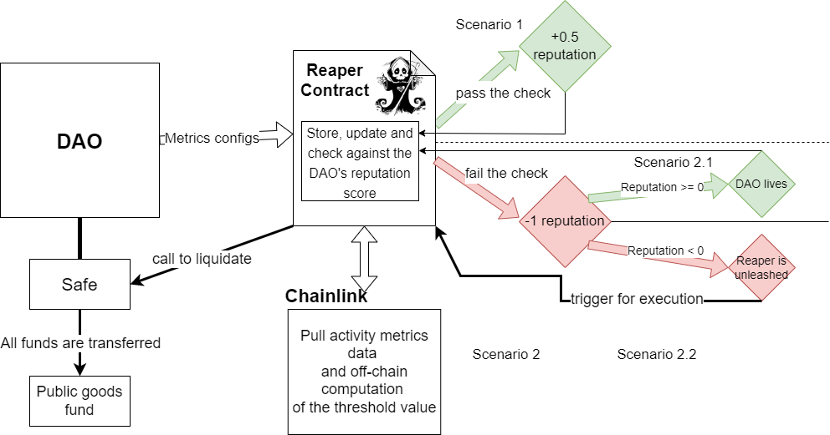
How it works

Slide 7
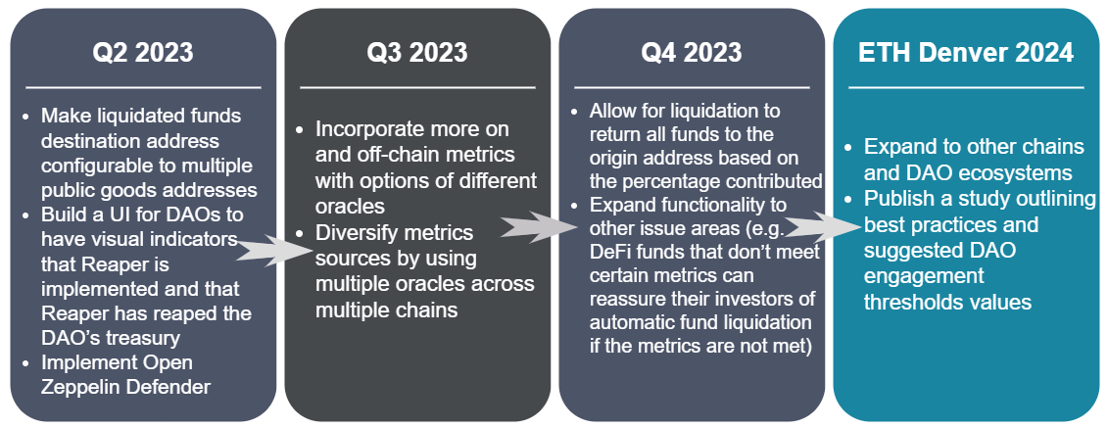
Future Scope

Slide 8
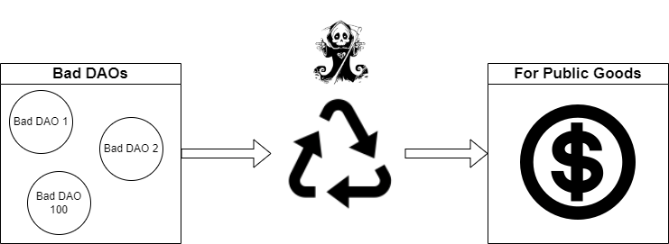
Potential Impact
Besides improving the DAO ecosystem with reputation scoring, engagement incentives and making treasury capture more difficult, our project has the potential to donate over 200 million dollars to public goods

